Slide 1

Bangladesh Army International University of Science & Technology (BAIUST)
Course Code : CSE -220
Course Title : Java Sessional
Submitted to,
Meskat Jahan
Lecturer, Dept. of CSE,
BAIUST, Comilla Cantonment, Comilla.
Submitted By,
S M Faiaz Tamim – 1103050
Taslima Akter – 1103091
Farjana Akter - 1103061

Slide 2
Presentation Topic
Making a Calculator in Java

Slide 3
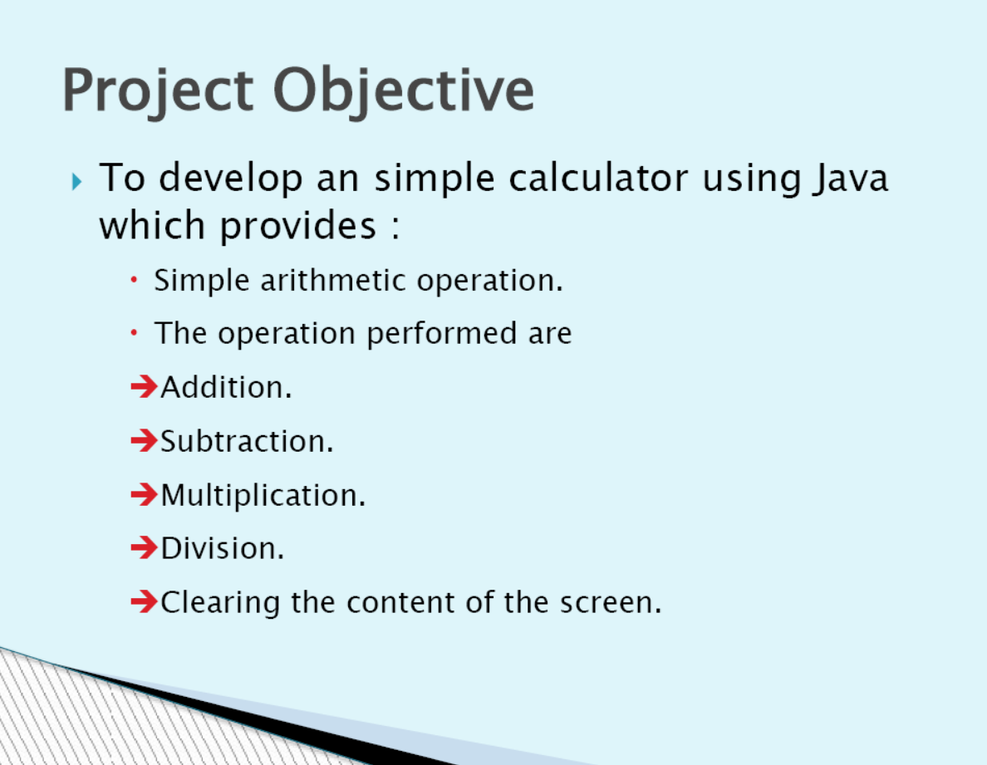

Slide 4
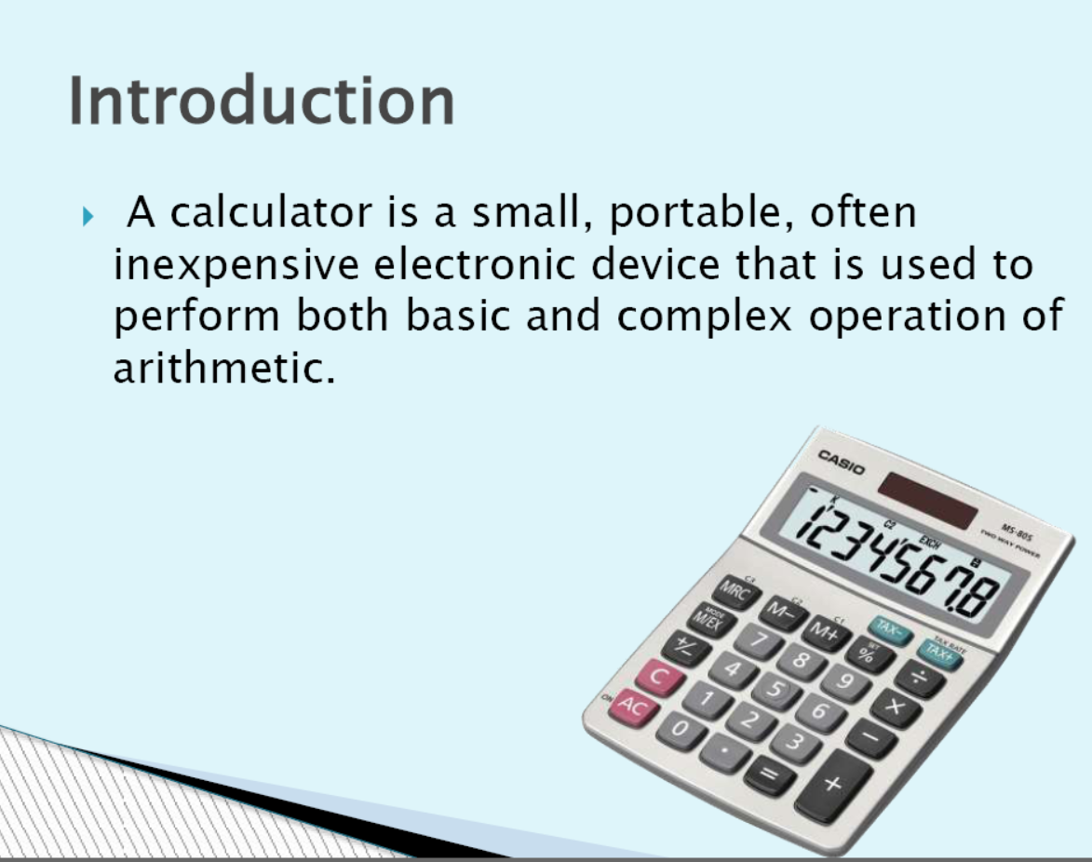

Slide 5
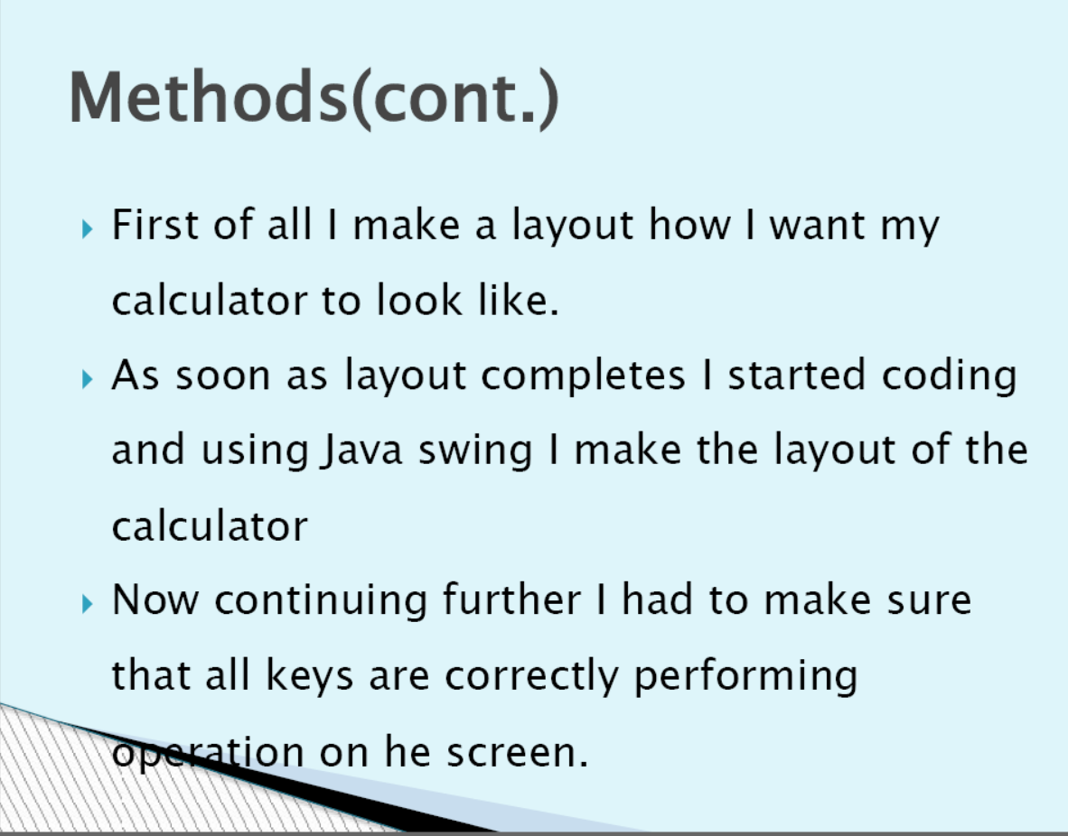

Slide 6
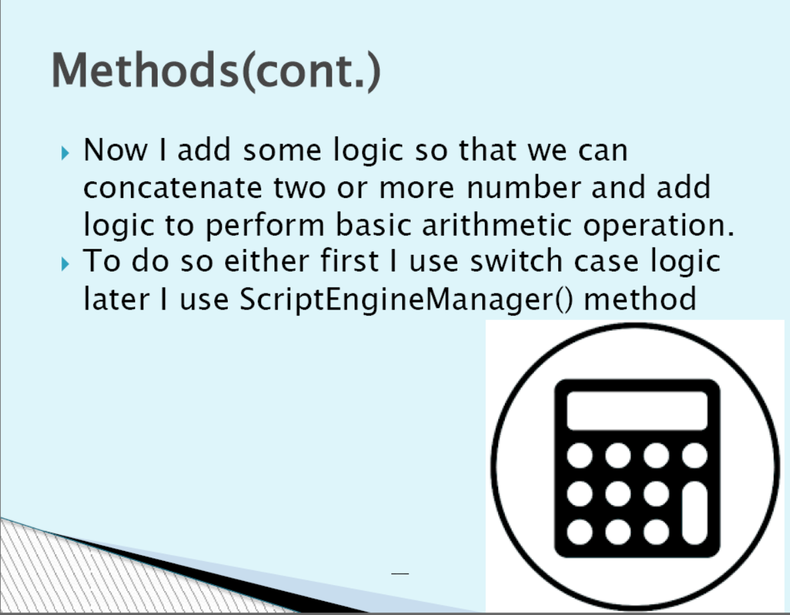

Slide 7
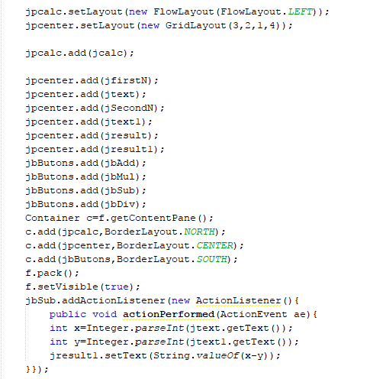
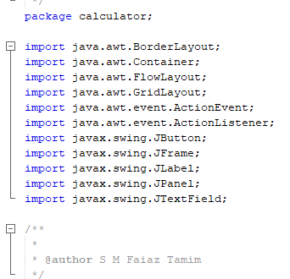
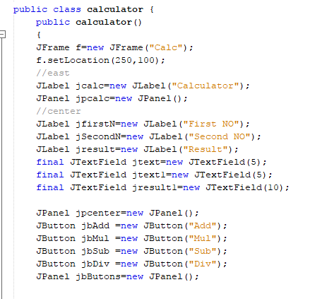
Code Segment
Class header & variable declaration
Import segment

Slide 8
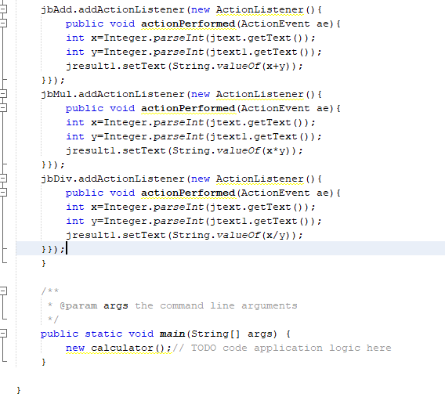
Add, Sub, Multi, Div Segment

Slide 9
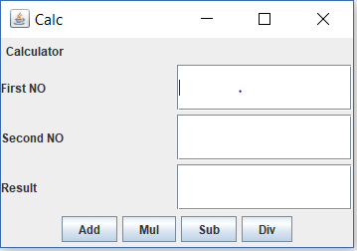
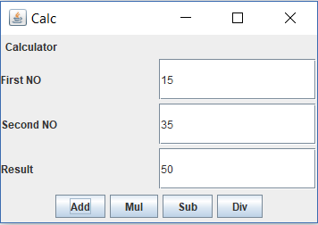
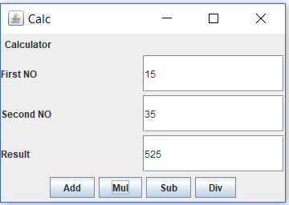
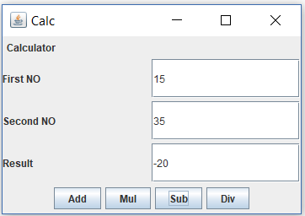
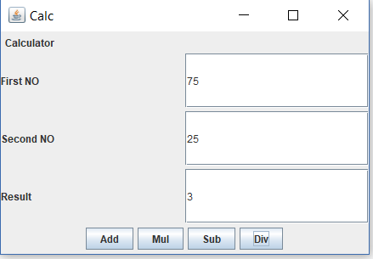
Output
Addition
Multiplication
Subtraction
Division

Slide 10
Thank You

